Slide 1
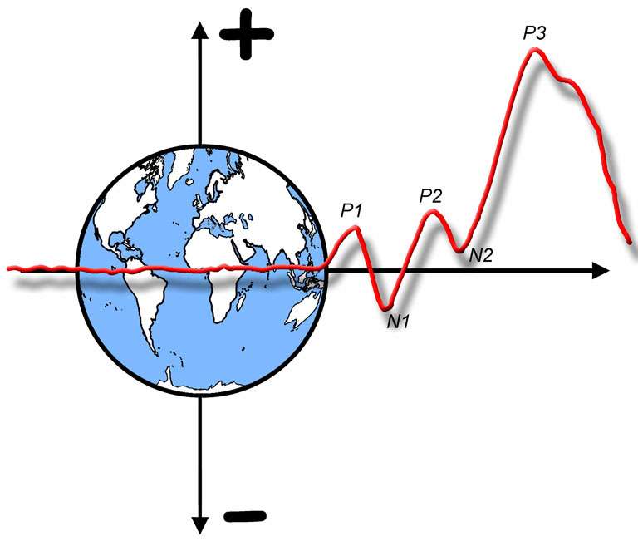

The ERP Boot Camp
What Are ERPs and What Are They Good For?

Slide 2
Overview
A bit of history: The first cognitive ERP study
Review: Basic electricity & neurophysiology
Neural origins of ERPs
What are ERPs good for?
Notes:
© S. J. Luck. All Rights Reserved. May be used for nonprofit educational purposes if this copyright notice is included. Permission must be obtained from the copyright holder(s) for any other use.

Slide 3
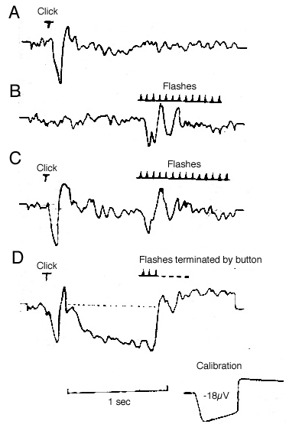
The First Cognitive ERP Study
1964: Gray Walter and the CNV
No Task: Click Only
No Task: Flashes Only
No Task: Click followed by flashes
Task: Press button when flashes start
CNV
Walter, W. G., Cooper, R., Aldridge, V. J., McCallum, W. C., & Winter, A. L. (1964). Contingent negative variation: An electric sign of sensorimotor association and expectancy in the human brain. Nature, 203, 380-384.
Notes:
Figure 1 from Walter, W. G., Cooper, R., Aldridge, V. J., McCallum, W. C., & Winter, A. L. (1964). Contingent negative variation: An electric sign of sensorimotor association and expectancy in the human brain. Nature, 203, 380-384. Reprinted by permission from Macmillan Publishers Ltd: NATURE (203) copyright (1964). This material may be used for nonprofit research and education purposes only, and it may not be reprinted or distributed in any form including print and electronic forms.
Other content: © S. J. Luck. All Rights Reserved. May be used for nonprofit educational purposes if this copyright notice is included. Permission must be obtained from the copyright holder(s) for any other use.

Slide 4
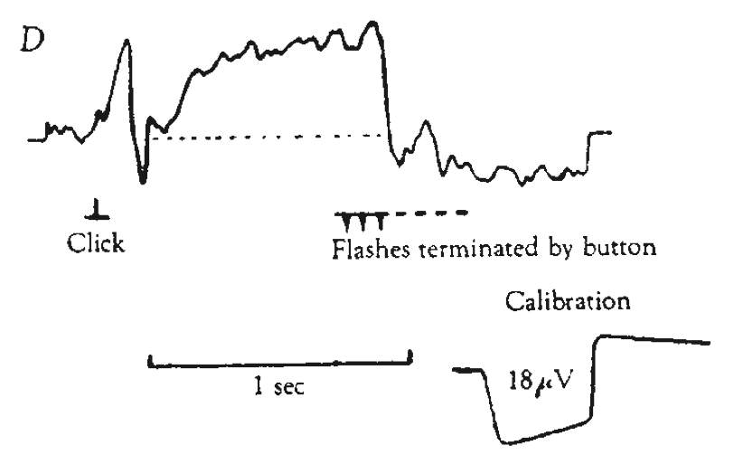
Which Way is Up?
Walter, W. G., Cooper, R., Aldridge, V. J., McCallum, W. C., & Winter, A. L. (1964). Contingent negative variation: An electric sign of sensorimotor association and expectancy in the human brain. Nature, 203, 380-384.
Notes:
Figure 1 from Walter, W. G., Cooper, R., Aldridge, V. J., McCallum, W. C., & Winter, A. L. (1964). Contingent negative variation: An electric sign of sensorimotor association and expectancy in the human brain. Nature, 203, 380-384. Reprinted by permission from Macmillan Publishers Ltd: NATURE (203) copyright (1964). This material may be used for nonprofit research and education purposes only, and it may not be reprinted or distributed in any form including print and electronic forms.

Slide 5
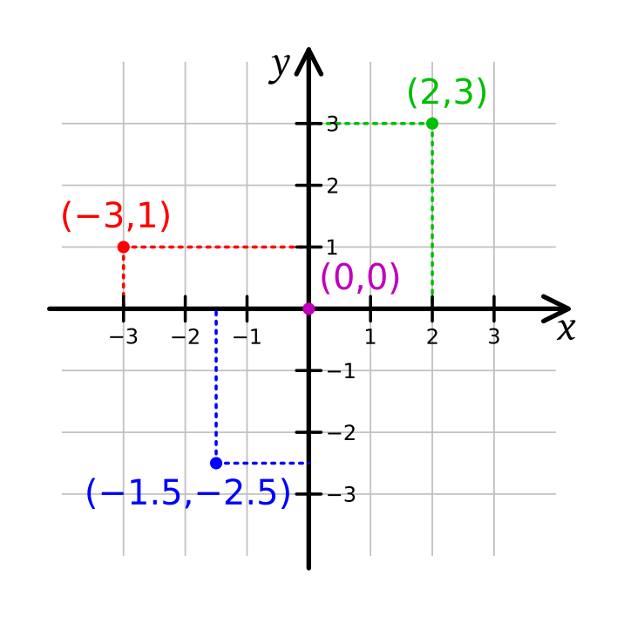
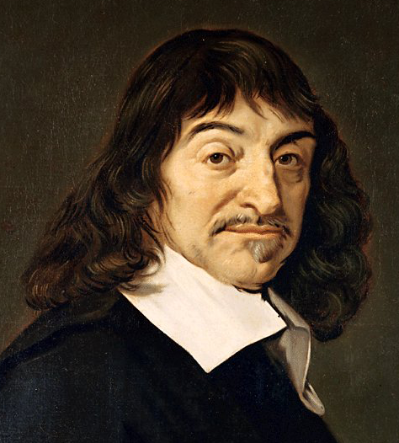
Which Way is Up?
René Descartes
Notes:
Public domain painting of Descartes from wikipedia
Public domain example of Cartesian coordinate system from wikipedia
Other content: © S. J. Luck. All Rights Reserved. May be used for nonprofit educational purposes if this copyright notice is included. Permission must be obtained from the copyright holder(s) for any other use.

Slide 6
The Oddball Paradigm
= Standard
Typical Task Alternatives:
Count oddballs
Press only for oddballs
Different buttons for standard, oddball
= Deviant/Oddball/Target
P3
P2
N2
Notes:
© S. J. Luck. All Rights Reserved. May be used for nonprofit educational purposes if this copyright notice is included. Permission must be obtained from the copyright holder(s) for any other use.

Slide 7
Some Terminology
Stimulus Onset Asynchrony
(SOA)
Duration
Interstimulus Interval
(ISI)
SOA
Intertrial Interval
(ITI)
ISI
Notes:
© S. J. Luck. All Rights Reserved. May be used for nonprofit educational purposes if this copyright notice is included. Permission must be obtained from the copyright holder(s) for any other use.

Slide 8
Some Basics of Neuroscience
Resting membrane potential
-70 mV on inside of cell
Action potentials
Triggered when membrane potential goes sufficiently positive
Starts at axon hillock and travels down axon
Rarely contributes to scalp ERPs
Postsynaptic potentials (PSPs)
Neurotransmitter binds with receptor, opens ion channels
Excitatory: Positive charges move into cell
Inhibitory: Negative charges move into cell
The origin of most ERPs
Notes:
© S. J. Luck. All Rights Reserved. May be used for nonprofit educational purposes if this copyright notice is included. Permission must be obtained from the copyright holder(s) for any other use.

Slide 9
Some Basics of Electricity
AC is “Alternating Current”
Changes fairly rapidly over time
Line current (50 or 60 Hz)
EEG
DC is “Direct Current”
Fairly constant “offset” in voltage
Batteries
Skin potentials
In discussions of amplifiers, DC can also mean “Direct Coupled” (as opposed to capacitively coupled)
Conveniently, this means that a DC (direct coupled) amplifier can amplify DC (direct current) signals
Notes:
© S. J. Luck. All Rights Reserved. May be used for nonprofit educational purposes if this copyright notice is included. Permission must be obtained from the copyright holder(s) for any other use.

Slide 10
Some Basics of Electricity
Current (I for Intensity; Amperes)
Movement of charges across space (coulombs per second)
Like rate of water coming out of a hose (liters per second)
Voltage (E for Electromotive Force; Volts)
Potential for charges to move
Like water pressure
Resistance (R; Ohms [Ω])
Resistance to movement of charges
Like having a skinny or blocked hose segment
Impedance (Z)
Resistance to the flow of alternating current (AC)
Combines resistance, capacitance, and inductance
Notes:
© S. J. Luck. All Rights Reserved. May be used for nonprofit educational purposes if this copyright notice is included. Permission must be obtained from the copyright holder(s) for any other use.

Slide 11
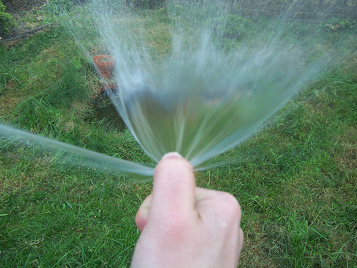
Some Basics of Electricity
Power (Watts) = EI (typically proportional to E²)
Power = Amplitude²
Amplitude = sqrt(Power)
Ohm’s Law: E = IR
If resistance increases and current is constant, voltage increases!
If you keep total water flow constant but constrict part of the hose, the pressure increases
Notes:
© S. J. Luck. All Rights Reserved. May be used for nonprofit educational purposes if this copyright notice is included. Permission must be obtained from the copyright holder(s) for any other use.

Slide 12
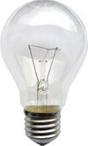
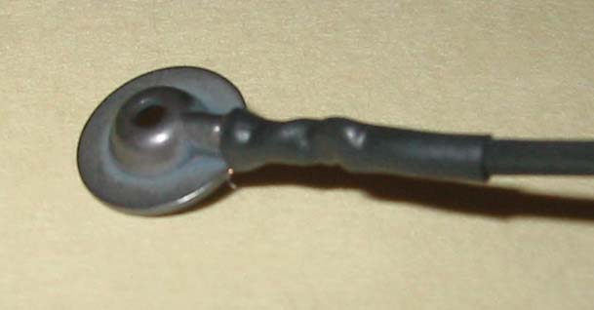
Some Basics of Electricity
Induction
If you pass an electrical current through a conductor, a magnetic field will run around it (right-hand rule)
If you pass a magnetic field across a conductor, an electrical current is induced in the conductor
Notes:
© S. J. Luck. All Rights Reserved. May be used for nonprofit educational purposes if this copyright notice is included. Permission must be obtained from the copyright holder(s) for any other use.

Slide 13
Where Do ERPs Come From?
Cortical pyramidal cell (basic input-output cell of cerebral cortex)
Excitatory transmitter released on apical dendrites causes positive charges to flow into dendrites
Net negative on outside of cell
Current flows through cell, completing the circuit
Polarity reverses with inhibitory transmitter
Polarity reverses with PSP on cell body and basal dendrites
Polarity at scalp also depends on orientation of the cortical surface and position of reference electrode
For a recent review, see Buzsáki, Anastassiou, & Koch (2012, Nature Reviews Neuroscience)
Notes:
Portion of Figure 5.2 reprinted from Luck, S. J., & Girelli, M. (1998). Electrophysiological approaches to the study of selective attention in the human brain. In R. Parasuraman (Ed.), The Attentive Brain (pp. 71-94). Cambridge, MA: MIT Press. © MIT Press. This material may be used for nonprofit research and education purposes only, and it may not be reprinted or distributed in any form including print and electronic forms.
Other content: © S. J. Luck. All Rights Reserved. May be used for nonprofit educational purposes if this copyright notice is included. Permission must be obtained from the copyright holder(s) for any other use.

Slide 14
Where Do ERPs Come From?
Equivalent Current Dipole
To be recorded at a distance, large numbers of neurons must have similar voltage fields
Notes:
Portion of Figure 5.2 reprinted from Luck, S. J., & Girelli, M. (1998). Electrophysiological approaches to the study of selective attention in the human brain. In R. Parasuraman (Ed.), The Attentive Brain (pp. 71-94). Cambridge, MA: MIT Press. © MIT Press. This material may be used for nonprofit research and education purposes only, and it may not be reprinted or distributed in any form including print and electronic forms.
Other content: © S. J. Luck. All Rights Reserved. May be used for nonprofit educational purposes if this copyright notice is included. Permission must be obtained from the copyright holder(s) for any other use.

Slide 15
Where Do ERPs Come From?
Open Field
Closed Field
Scalp-recorded potentials are possible only for layered structures with consistent orientations
Primarily cerebral cortex
What about:
Brainstem nuclei?
Superior colliculus?
Possible role of radial glia
Local Field Potentials
Notes:
© S. J. Luck. All Rights Reserved. May be used for nonprofit educational purposes if this copyright notice is included. Permission must be obtained from the copyright holder(s) for any other use.

Slide 16
Where Do ERPs Come From?
Voltages spread through the brain by “volume conduction”
Nearly speed of light
Voltage everywhere except at positive-negative transition
Skull causes lateral spread (like spraying hose on cardboard)
Notes:
Portion of Figure 5.2 reprinted from Luck, S. J., & Girelli, M. (1998). Electrophysiological approaches to the study of selective attention in the human brain. In R. Parasuraman (Ed.), The Attentive Brain (pp. 71-94). Cambridge, MA: MIT Press. © MIT Press. This material may be used for nonprofit research and education purposes only, and it may not be reprinted or distributed in any form including print and electronic forms.
© S. J. Luck. All Rights Reserved. May be used for nonprofit educational purposes if this copyright notice is included. Permission must be obtained from the copyright holder(s) for any other use.

Slide 17
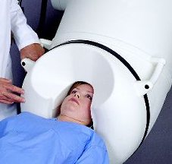
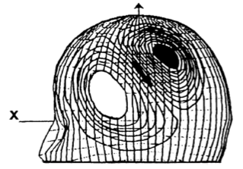
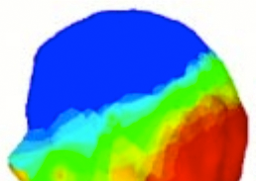
Magnetoencephalography (MEG)
Efflux
–
Example:
Mismatch
Negativity
Influx
+
Woldorff et al (1993)
Magnetic Field
Voltage Distribution
The skull is transparent to magnetism -- less blurring
Deep and radial dipoles are invisible from outside the head
Notes:
Portion of Figure 5.2 from Luck, S. J., & Girelli, M. (1998). Electrophysiological approaches to the study of selective attention in the human brain. In R. Parasuraman (Ed.), The Attentive Brain (pp. 71-94). Cambridge, MA: MIT Press.
Photo from http://www.4dneuroimaging.com/Magnes%20Product%20Line.html
This material may be used for nonprofit research and education purposes only, and it may not be reprinted or distributed in any form including print and electronic forms.

Slide 18
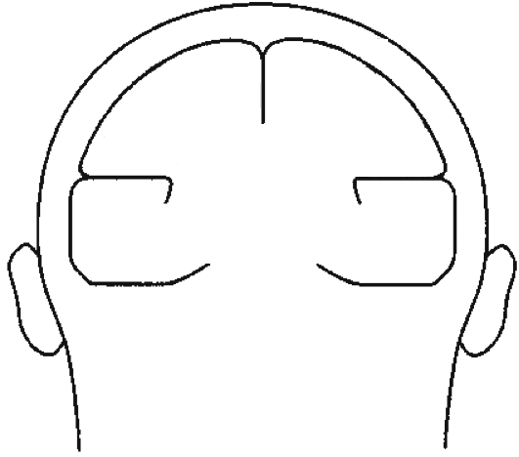
The Superposition Problem
C1
C2
C3
w_{1,1}
E1
w_{2,1}
w_{3,1}
w_{1,2}
w_{2,2}
E2
w_{3,2}
w_{1,3}
w_{2,3}
E3
w_{3,3}
E1
E2
Voltage at an electrode at time t is a weighted sum of all components that are active at time t
There is no foolproof way to recover the underlying components from the observed waveforms
C3
E3
C1
C2
Notes:
© S. J. Luck. All Rights Reserved. May be used for nonprofit educational purposes if this copyright notice is included. Permission must be obtained from the copyright holder(s) for any other use.

Slide 19
Stimulus Onset
Task-Dependent Categorization
Post-Response Evaluation
Prestimulus Preparatory Processes
Initial Sensory Response
Response Selection
Higher Perceptual Processes
Working Memory Encoding
Notes:
© S. J. Luck. All Rights Reserved. May be used for nonprofit educational purposes if this copyright notice is included. Permission must be obtained from the copyright holder(s) for any other use.

Slide 20
Clap once if you see a person in the following photograph
Notes:
© S. J. Luck. All Rights Reserved. May be used for nonprofit educational purposes if this copyright notice is included. Permission must be obtained from the copyright holder(s) for any other use.

Slide 21
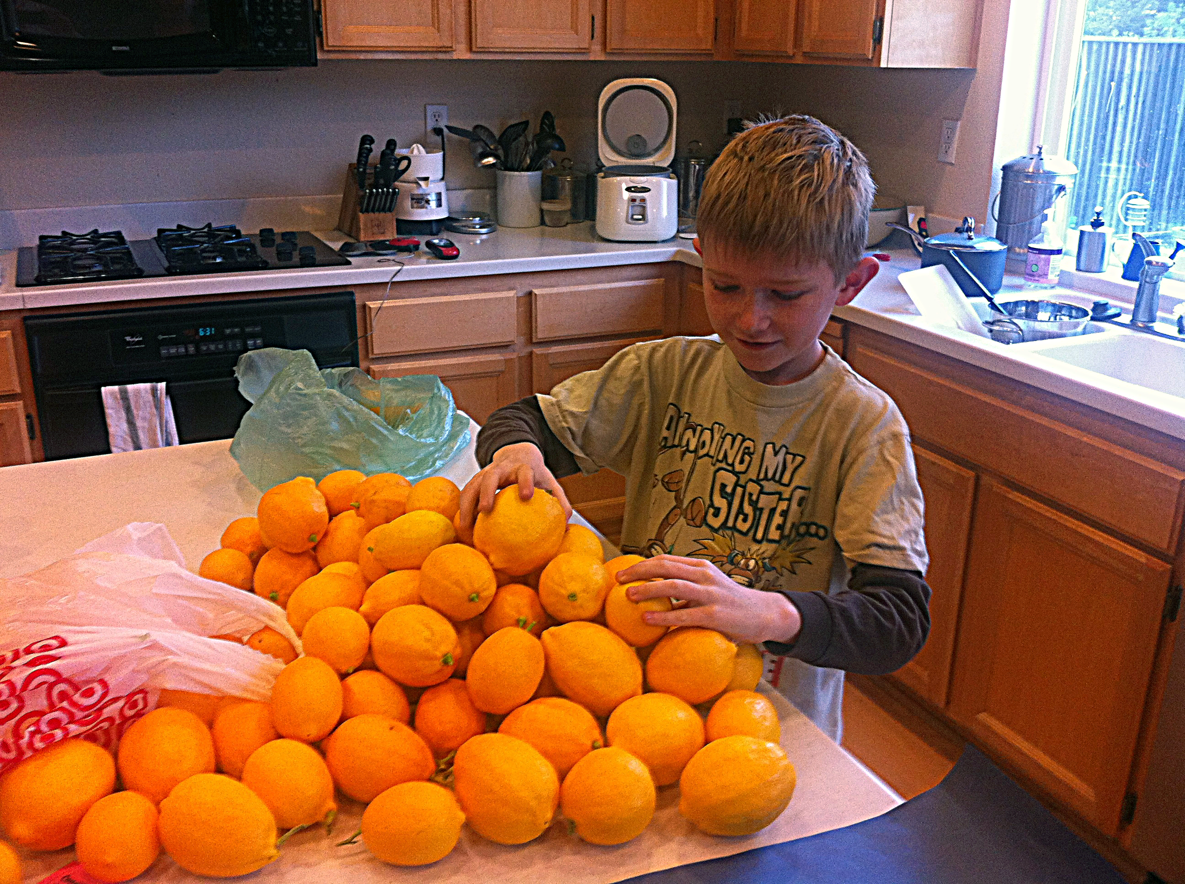
Notes:
© S. J. Luck. All Rights Reserved. May be used for nonprofit educational purposes if this copyright notice is included. Permission must be obtained from the copyright holder(s) for any other use.

Slide 22
Notes:
© S. J. Luck. All Rights Reserved. May be used for nonprofit educational purposes if this copyright notice is included. Permission must be obtained from the copyright holder(s) for any other use.

Slide 23
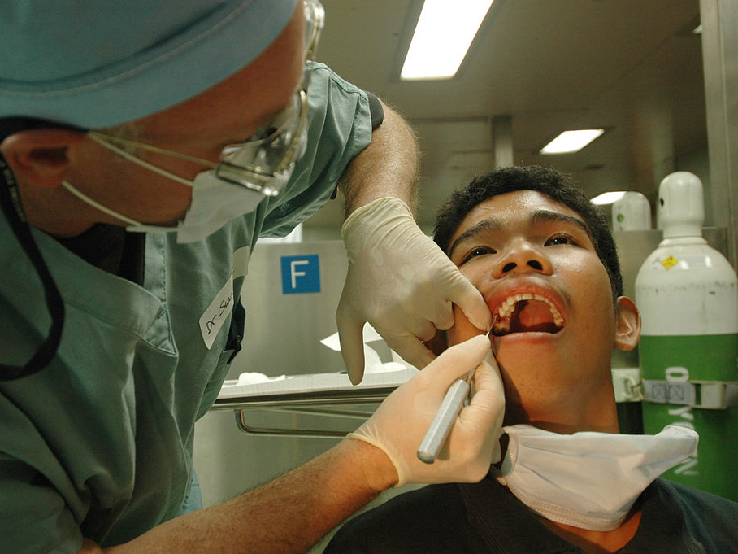
Notes:
https://commons.wikimedia.org/wiki/File:US_Navy_060607-N-2832L-053_Air_Force_Col._Jeffrey_Swartz,_a_dentist,_pulls_teeth_from_patients_aboard_the_U.S._Military_Sealift_Command_(MSC)_hospital_ship_USNS_Mercy_(T-AH_19).jpg
Public Domain

Slide 24
Notes:
© S. J. Luck. All Rights Reserved. May be used for nonprofit educational purposes if this copyright notice is included. Permission must be obtained from the copyright holder(s) for any other use.

Slide 25
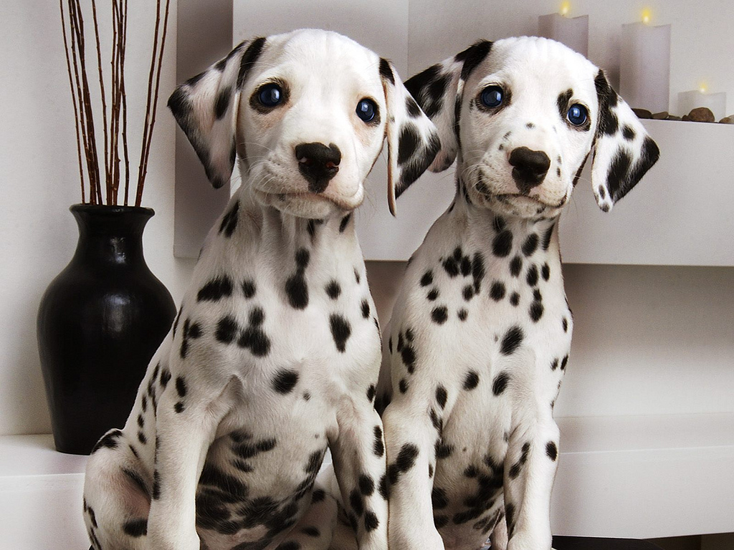
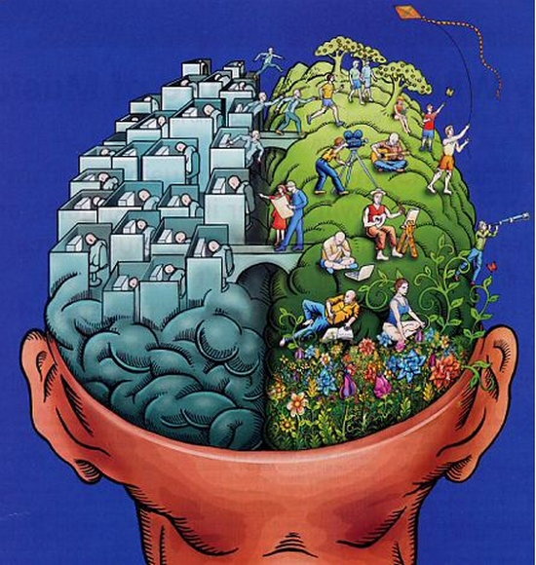
An Example:
Visual Working Memory
Notes:
http://www.flickr.com/photos/myheimu/7995211914
Creative Commons 2.0

Slide 26
Notes:
Annoying my sister – one of the many services I offer

Slide 27
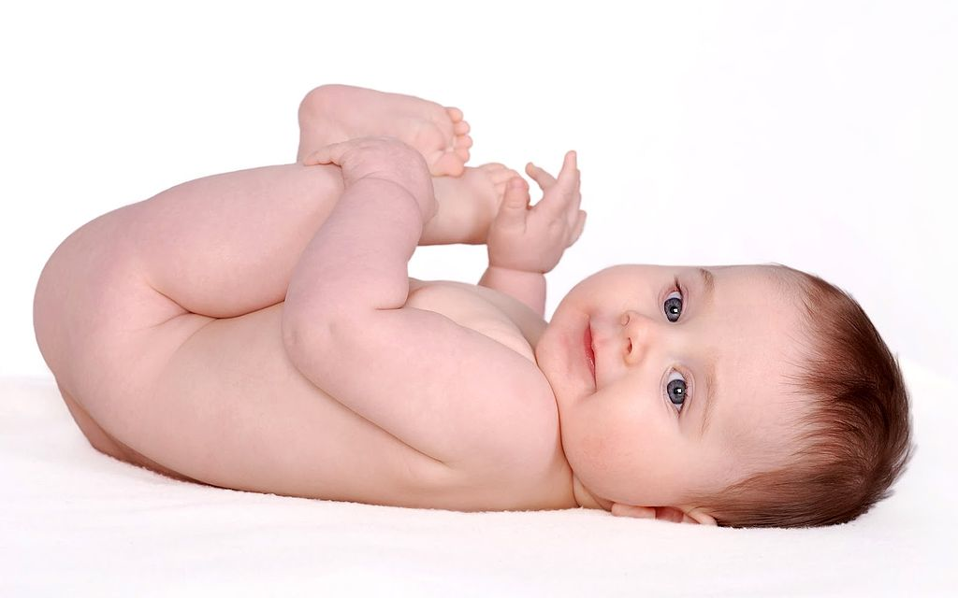
An Example:
Visual Working Memory
Notes:
https://commons.wikimedia.org/wiki/File:Baby_on_Back.jpg
Creative Commons 3.0

Slide 28
Notes:
Annoying my sister – one of the many services I offer

Slide 29
Temporal Resolution
Gist of a scene available within 150-250 ms
Eye movements every 200-500 ms
Low-level sensory processing
Focus attention on relevant information
Identify it
Store it in working memory
Find next saccade target
Program and execute eye movement
ERPs allow us to measure these individual processes as they are happening
Notes:
© S. J. Luck. All Rights Reserved. May be used for nonprofit educational purposes if this copyright notice is included. Permission must be obtained from the copyright holder(s) for any other use.

Slide 30
Temporal Resolution
In behavioral button-press tasks, all this stuff is combined into a single output
In fMRI, all is collapsed into a single time slice
ERPs:
Notes:
© S. J. Luck. All Rights Reserved. May be used for nonprofit educational purposes if this copyright notice is included. Permission must be obtained from the copyright holder(s) for any other use.

Slide 31

What are ERPs Good For?
All the good stuff
Stimulus
Response
Notes:
© S. J. Luck. All Rights Reserved. May be used for nonprofit educational purposes if this copyright notice is included. Permission must be obtained from the copyright holder(s) for any other use.

Slide 32
What are ERPs Good For?
Determine whether an experimental manipulation influenced Process A or Process B
What was the onset time of the difference?
Which ERP component was affected by the manipulation?
Identifying multiple neurocognitive processes
A given behavioral effect is often accompanied by multiple ERP effects (different components)
Easy to identify multiple processes contributing to behavior
Covert monitoring of processing
Processing can be measured without a behavioral response (or from subjects who cannot easily respond)
Did the brain do something that was not evident in behavior?
Notes:
© S. J. Luck. All Rights Reserved. May be used for nonprofit educational purposes if this copyright notice is included. Permission must be obtained from the copyright holder(s) for any other use.

Slide 33
What are ERPs Good For?
Link to the brain
Under some conditions, neural systems can be identified
But people often draw unwarranted conclusions about underlying neural processes from ERPs
Many researchers desperately want ERPs to be like fMRI or single-unit recordings, but they are not
“Those English boys want to play the blues so bad—and they DO play it so bad” — Sonny Boy Williamson
“Those ERPers want to study the brain so bad—and they DO study it so bad” — Sonny Boy Luck
Notes:
© S. J. Luck. All Rights Reserved. May be used for nonprofit educational purposes if this copyright notice is included. Permission must be obtained from the copyright holder(s) for any other use.

Slide 34
ERPs as Biomarkers
See Luck et al. (2011, Biological Psychiatry)
ERPs are tightly tied to neurotransmission
MMN may reflect current flow through NMDA receptors
A change in ERPs reflects a change in PSPs (not mediated through hemodynamic response)
Rodent/primate models available for some components
Potentially useful as an assay in drug discovery
Easily tolerated by patients
Some paradigms have excellent stability, reliability
Relatively inexpensive, feasible for large-N studies
May be able to predict which patients will respond to a given treatment
Potential roadblocks
Individual differences, lack of quality assurance standards
Notes:
© S. J. Luck. All Rights Reserved. May be used for nonprofit educational purposes if this copyright notice is included. Permission must be obtained from the copyright holder(s) for any other use.

Slide 35
ERPs May be Bad When…
You desire certainty about the neuroanatomical locus of an effect
You are interested in activity that is slow (>~2 s) or not time-locked to a sudden, observable event
You cannot collect large numbers of trials in each critical condition
Long period of time between trials
Severe adaptation of response over trials
Need to surprise subjects
The process of interest does not have an ERP signature
Subjects make frequent head, eye, or mouth movements during the time period of interest
Speech is particularly bad (tongue has strong dipole)
Notes:
© S. J. Luck. All Rights Reserved. May be used for nonprofit educational purposes if this copyright notice is included. Permission must be obtained from the copyright holder(s) for any other use.

Slide 36
Drift Over Time
Notes:
© S. J. Luck. All Rights Reserved. May be used for nonprofit educational purposes if this copyright notice is included. Permission must be obtained from the copyright holder(s) for any other use.

Slide 37
Comparison of Techniques
Also…
If you want to study the sequence of processes from 0-1000 ms, use ERPs; if you want to differentiate V2 from V4, use fMRI
Tolerability: Infants and children, obese people, anxious people
ERPs best for transient activity; fMRI best for sustained activity
Brain areas more intrinsically meaningful than ERP components
Notes:
© S. J. Luck. All Rights Reserved. May be used for nonprofit educational purposes if this copyright notice is included. Permission must be obtained from the copyright holder(s) for any other use.

